Slide 1
EAP-AKA’ in 5GS

Slide 2
Let’s start from EAP-AKA.

Slide 3
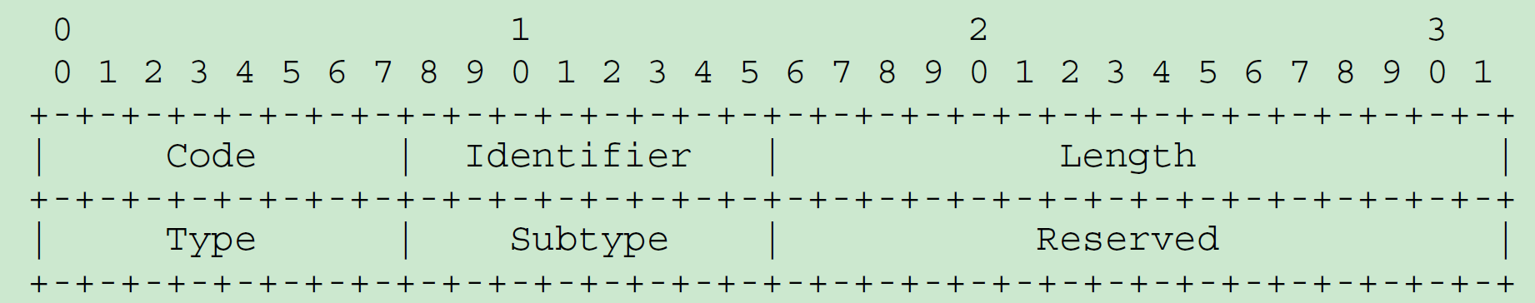
EAP-AKA [rfc4178] – message format
Code：
1 Request
2 Response
3 Success
4 Failure
Subtype：
AKA-Challenge...................................1
AKA-Authentication-Reject.......................2
AKA-Synchronization-Failure.....................4
AKA-Identity....................................5
SIM-Start......................................10
SIM-Challenge..................................11
AKA-Notification and SIM-Notification..........12
AKA-Reauthentication and SIM-Reauthentication..13
AKA-Client-Error and SIM-Client-Error..........14
Identifier：matching Responses with Requests
Length：length of total EAP packet
Type：set to 23 for AKA
Reserved：set to zeros for further use

Slide 4
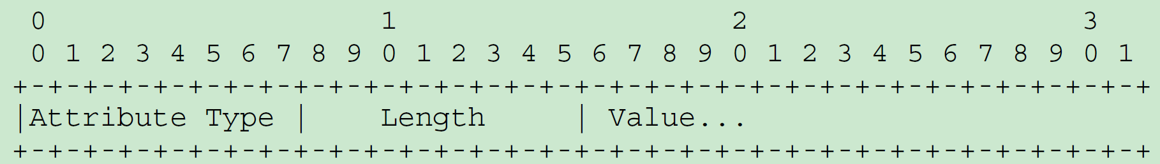
EAP-AKA [rfc4178] – attribute
AT_RAND.........................................1
AT_AUTN.........................................2
AT_RES..........................................3
AT_AUTS.........................................4
AT_PADDING......................................6
AT_NONCE_MT.....................................7
AT_PERMANENT_ID_REQ............................10
AT_MAC.........................................11
AT_NOTIFICATION................................12
AT_ANY_ID_REQ..................................13
AT_IDENTITY....................................14
AT_VERSION_LIST................................15
AT_SELECTED_VERSION............................16
AT_FULLAUTH_ID_REQ.............................17
AT_COUNTER.....................................19
AT_COUNTER_TOO_SMALL...........................20
AT_NONCE_S.....................................21
AT_CLIENT_ERROR_CODE...........................22
AT_IV.........................................129
AT_ENCR_DATA..................................130
AT_NEXT_PSEUDONYM.............................132
AT_NEXT_REAUTH_ID.............................133
AT_CHECKCODE..................................134
AT_RESULT_IND.................................135

Slide 5
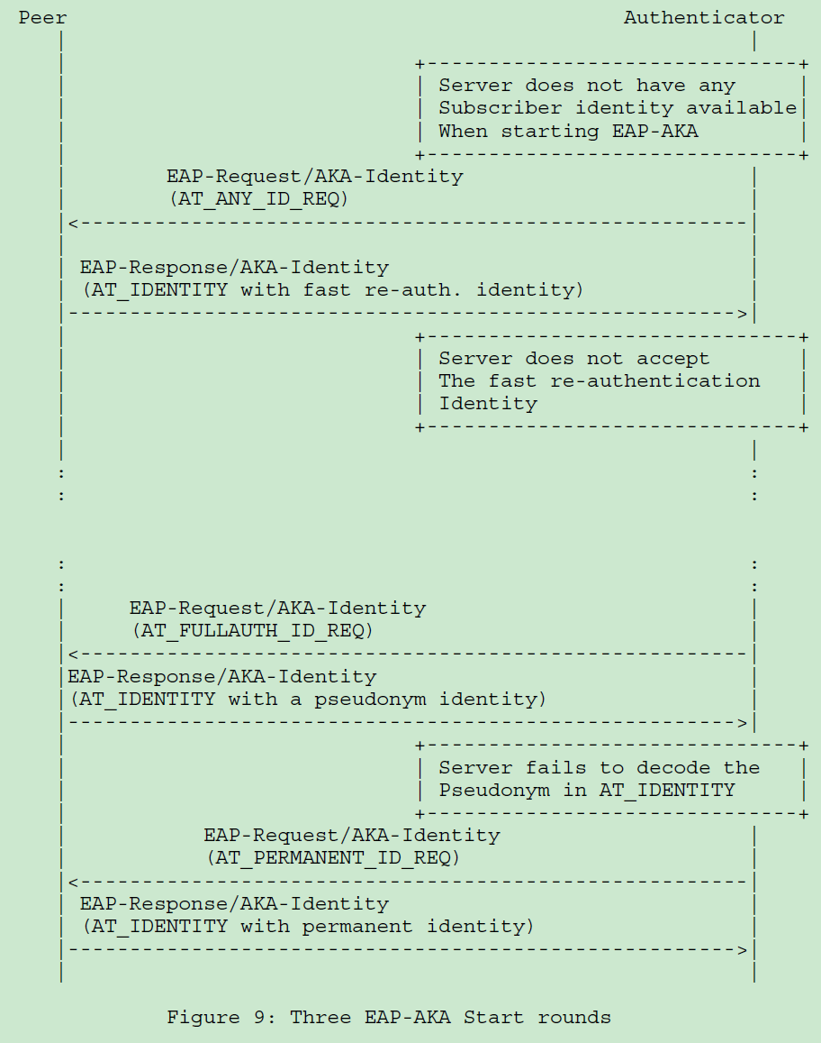
EAP-AKA [rfc4178] – identity negotiation
The sever sends three type of EAP-request/ AKA-Identity in turn:
AT_ANY_ID_REQ
AT_FULLAUTH_ID_REQ
AT_PERMANENT_ID_REQ
If any of them succeed, the identity negotiation ends, and sever begins to send EAP-request/ AKA-Challenge .
Else, the authentication fails.

Slide 6
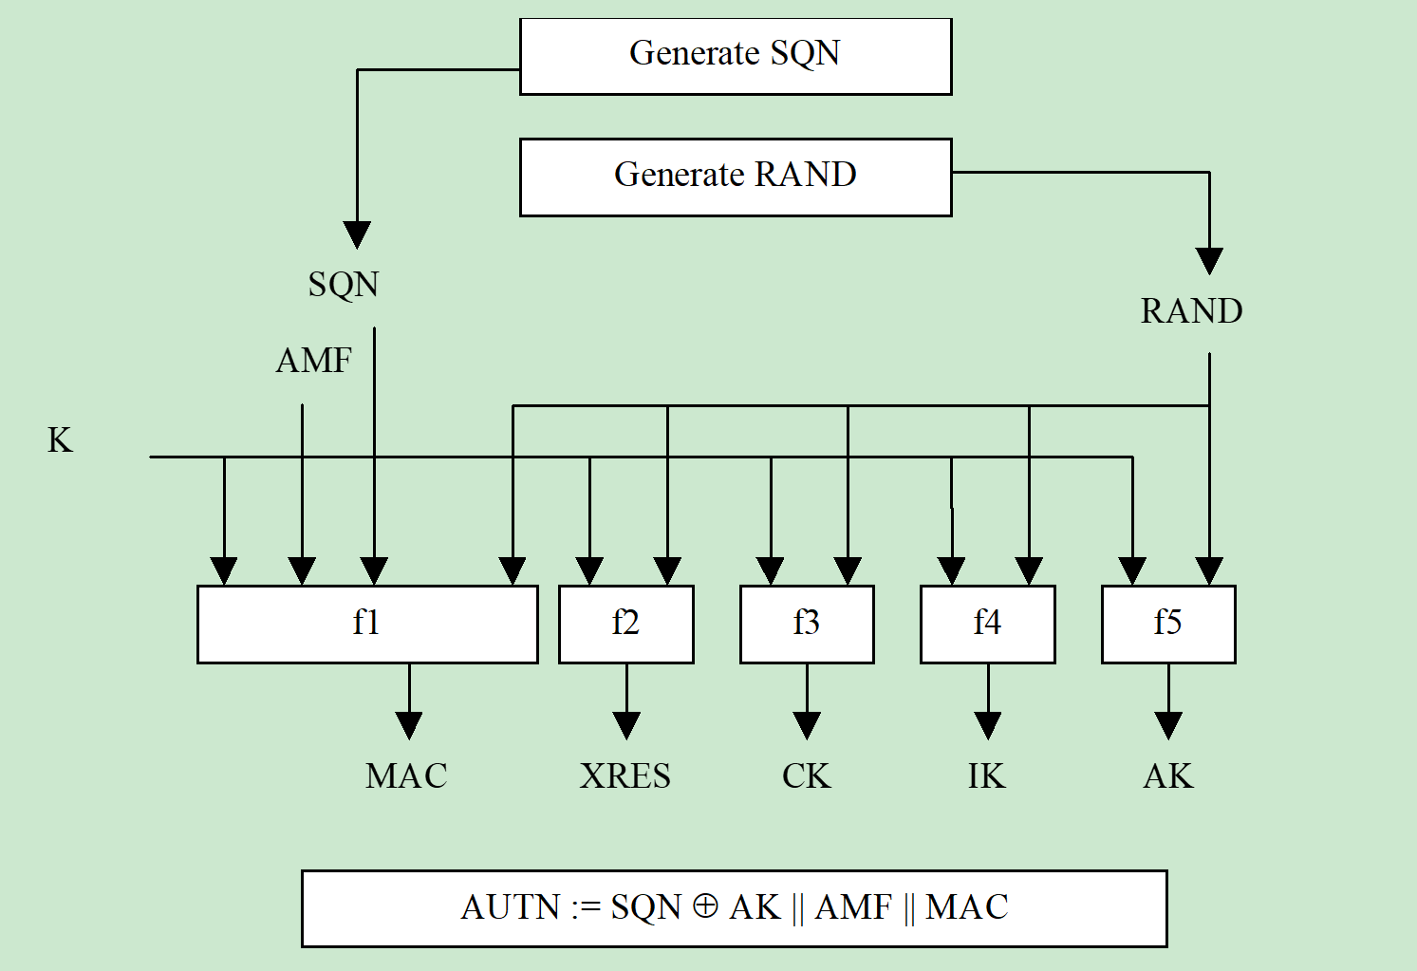
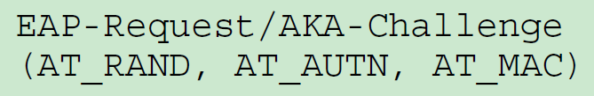
EAP-AKA [rfc4178] – AKA-challenge authentication token (AUTN) [33.102]
NOTE: No AV yet!
Because CK & IK are directly derived from shared long term key K, and there’s no need to deliver these parameters.
NOTE: AT_MAC != MAC
MAC provides integrity protection for AUTN;
AT_MAC provides integrity protection for the whole AKA-challenge packet.

Slide 7
Go ahead to EAP-AKA’ !

Slide 8
EAP-AKA’ [rfc5448] – general
This specification defines a new EAP method, EAP-AKA’, which is a small revision of the EAP-AKA (Extensible Authentication Protocol Method for 3rd Generation Authentication and Key Agreement) method.
The change is a new key derivation function that binds the keys derived within the method to the name of the access network. The new key derivation mechanism has been defined in the 3rd Generation Partnership Project (3GPP). This specification allows its use in EAP in an interoperable manner. In addition, EAP-AKA’ employs SHA-256 instead of SHA-1.

Slide 9
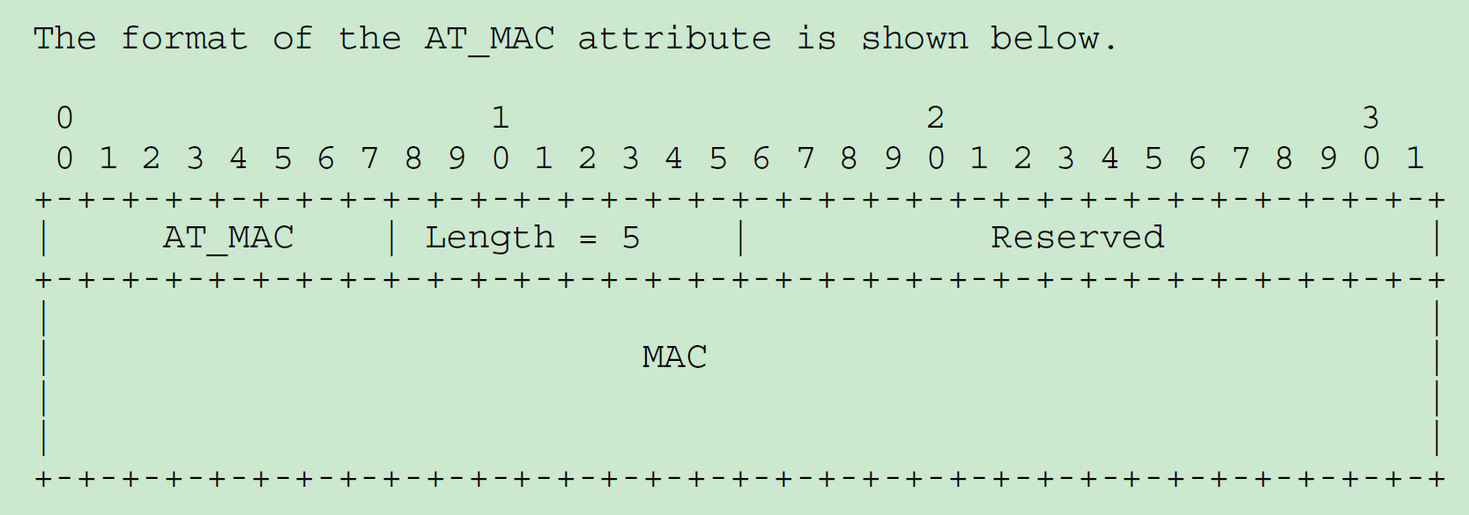
EAP-AKA’ [rfc5448] – AT_MAC
The MAC is calculated over the whole EAP packet and concatenated with optional message-specific data, with the exception that the value field of the MAC attribute is set to zero when calculating the MAC.
The MAC algorithm is HMAC-SHA-256-128, a keyed hash value. The HMAC-SHA-256-128 value is obtained from the 32-byte HMAC-SHA-256 value by truncating the output to the first 16 bytes. Hence, the length of the MAC is 16 bytes.

Slide 10
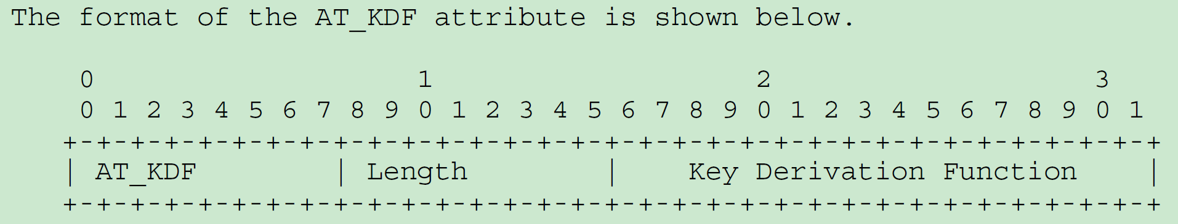
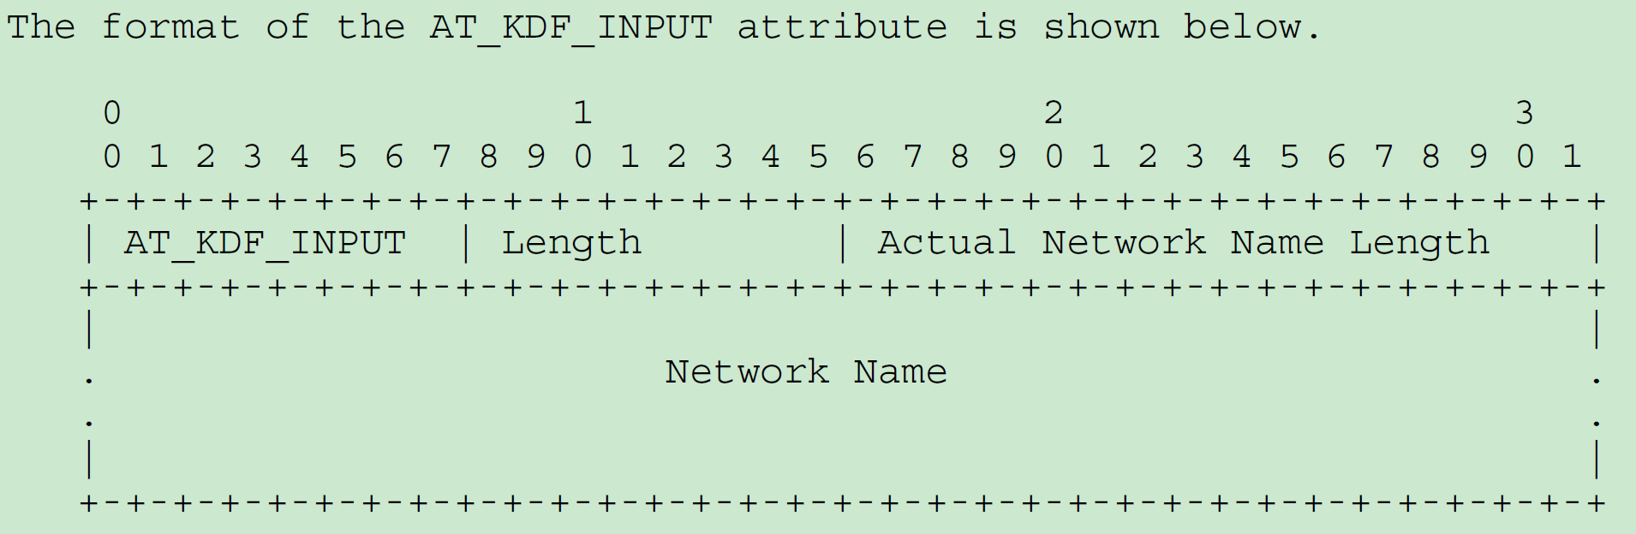
EAP-AKA’ [rfc5448] – AT_KDF & AT_KDF_INPUT
Key Derivation Function
An enumerated value representing the key derivation function that the server (or peer) wishes to use. Value 1 represents the default key derivation function for EAP-AKA’.
Network Name
The Network Name field contains a UTF-8 string. This string MUST be constructed as specified in [3GPP.24.302] for "Access Network Identity". The string is structured as fields separated by colons (:). The algorithms and mechanisms to construct the identity string depend on the used access technology.

Slide 11
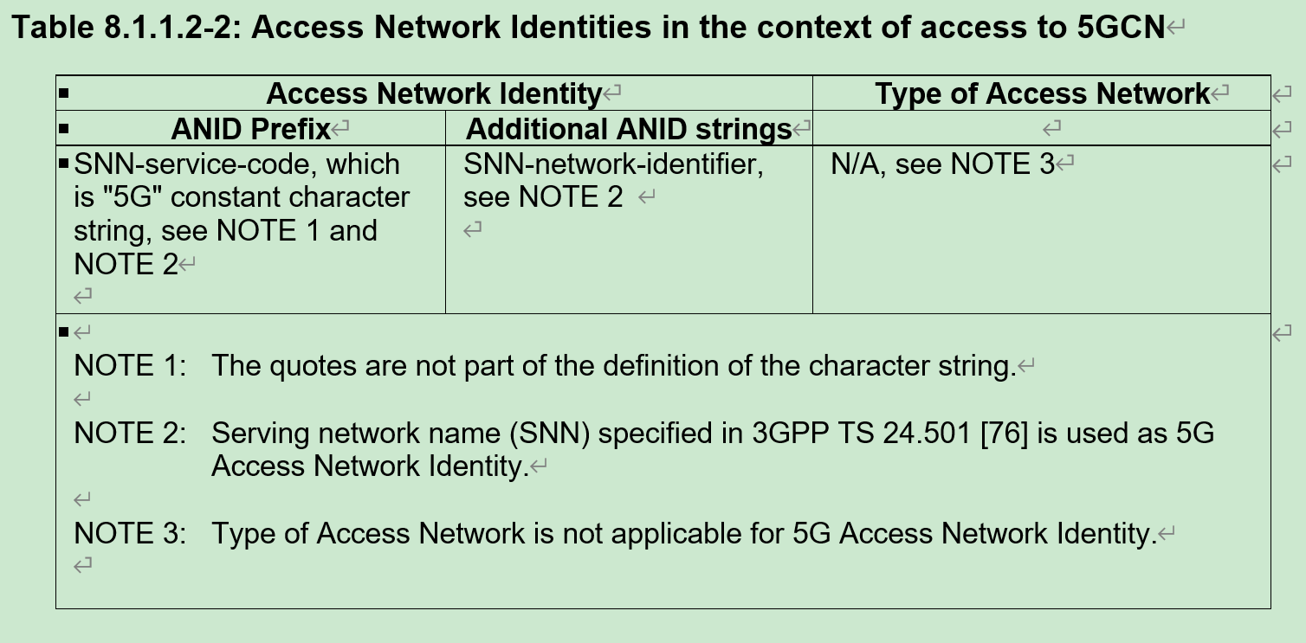
Access Network Identity(ANID) [24.302] Serving Network Name (SNN) [24.501]
NOTE: SNN-service-code allows for distinguishing of ANID specified in 3GPP TS 24.302 [16] and SNN as either of SNN or ANID can be carried in the AT_KDF_INPUT attribute.
EXAMPLE 1: In case of a PLMN, if PLMN ID contains MCC = 234 and MNC = 15, SNN is 5G:mnc015.mcc234.3gppnetwork.org.
EXAMPLE 2: In case of an SNPN, if SNPN ID contains a PLMN ID of MCC = 234 and MNC = 15 and an NID of 123ABH, SNN is 5G:mnc015.mcc234.3gppnetwork.org:123AB.

Slide 12
EAP-AKA’ [rfc5448] – key derivation
Both the peer and server MUST derive the keys as follows.
AT_KDF set to 1
In this case, MK is derived and used as follows:
MK = PRF’(IK’|CK’,"EAP-AKA’"|Identity)
K_encr = MK[0..127]
K_aut = MK[128..383]
K_re = MK[384..639]
MSK = MK[640..1151]
EMSK = MK[1152..1663]
K_encr is used by the AT_ENCR_DATA attribute, and
K_aut by the AT_MAC attribute.
K_re is used by fast re-authentication.
MSK and EMSK are outputs from a successful EAP method run [RFC3748].
PRF’(K,S) = T1 | T2 | T3 | T4 | ...
where:
T1 = HMAC-SHA-256 (K, S | 0x01)
T2 = HMAC-SHA-256 (K, T1 | S | 0x02)
T3 = HMAC-SHA-256 (K, T2 | S | 0x03)
T4 = HMAC-SHA-256 (K, T3 | S | 0x04)
...
The AUSF uses the most significant 256 bits of EMSK as the K_{AUSF}

Slide 13
Network Access Identifier (NAI) [rfc4282][rfc7542] NAI format for SUPI & SUCI [23.501][23.003]
NAI format for SUCI
Assuming the IMSI 234150999999999, where MCC=234, MNC=15 and MSIN=0999999999, the Routing Indicator 678, and a Home Network Public Key Identifier of 27, the NAI format for the SUCI takes the form:
- for the null-scheme:
type0.rid678.schid0.userid0999999999
- for the Profile <A> protection scheme:
type0.rid678.schid1.hnkey27.ecckey<ECC ephemeral public key>.cip< encryption of 0999999999>.mac<MAC tag value>
Assuming the Network Specific Identifier user17@example.com, the Routing Indicator 678, and a Home Network Public Key Identifier of 27, the NAI format for the SUCI takes the form:
- for the null-scheme:
type1.rid678.schid0.useriduser17@example.com
- for the Profile <A> protection scheme:
type1.rid678.schid1.hnkey27.ecckey<ECC ephemeral public key>.cip< encryption of user17>.mac<MAC tag value>@example.com

Slide 14
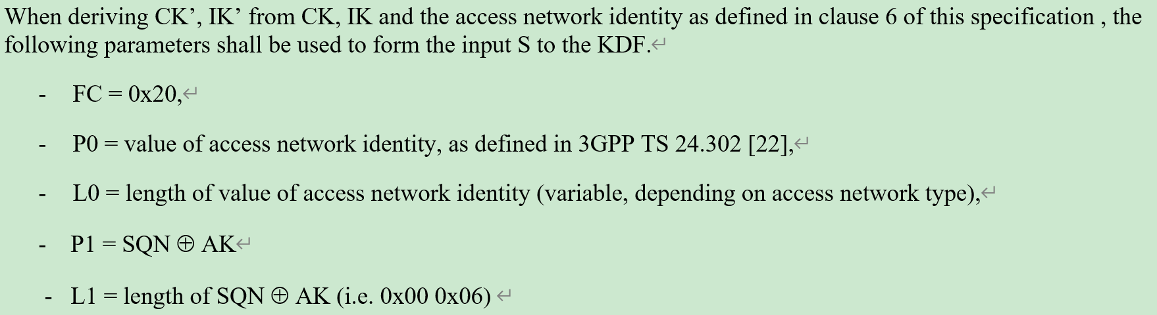
key derivation function (KDF) [33.220] IK’ & CK’ derivation [33.402]
S = FC || P0 || L0 || P1 || L1 || P2 || L2 || P3 || L3 ||... || Pn || Ln
FC is used to distinguish between different instances of the algorithm and is either a single octet or consists of two octets of the form FC1|| FC2 where FC1 = 0xFF and FC2 is a single octet,
P0 ... Pn are the n+1 input parameter encodings, and
L0 ... Ln are the two-octet representations of the length of the corresponding input parameter encodings P0.. Pn.
derived key = HMAC-SHA-256 ( Key , S )

Slide 15
How does EAP-AKA’ perform in 5GS ?
Remove support for fast re-authentication
Never expose peer(UE)’s permanent identity(SUPI)
Encapsulated into NAS format in order to correspond to 5G AKA
……

Slide 16
Further discussion
SQN, f1-f5 and etc. work in AUTN
NAS format with ngKSI, ABBA and etc.
Key derivation hierarchy and module function, especially AMF
5G AKA and GUTI
……

Slide 17
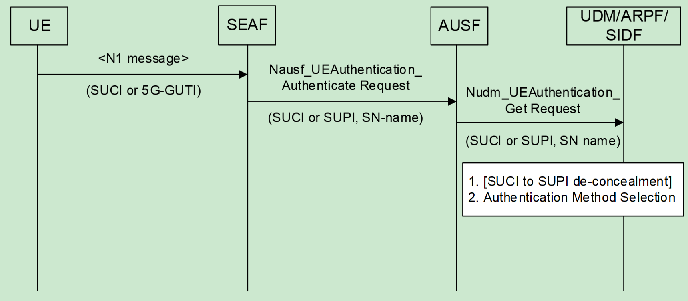
Further discussion
Why an authentication procedure begins with the sever in EAP-AKA?
It’s natural to initiate an authentication from UE with a message indicate its identity as shown on the right.

